Slide 1
PREVIOUS + THIS WEEK:
Nuclear Magnetic Resonance (NMR) spectroscopy
applied to Structural Biology
Luciano Abriata – Lab. for Biomol Model. / PTPSP facility / NMR facility
These classes are not at all deep (whole courses can be done dedicated to different sub-fields of NMR spectroscopy)…
… but neither are them too shallow: I try to balance practical applications with giving you some basic theoretical concepts.
NEW IN 2024: Blog posts with a written form of everything I tell you here
CHAPTER 1: https://medium.com/advances-in-biological-science/nuclear-magnetic-resonance-spectroscopy-the-overlooked-powerhouse-of-biology-chapter-1-7b3d74dad714
CHAPTER 2: https://medium.com/advances-in-biological-science/nuclear-magnetic-resonance-spectroscopy-the-overlooked-powerhouse-of-biology-chapter-2-f1e80e7a4b3
CHAPTER 3: https://lucianosphere.medium.com/nuclear-magnetic-resonance-spectroscopy-the-overlooked-powerhouse-of-biology-chapter-3-5fed9865afce
CHAPTERS 4 & 5: COMING SOON

Slide 2
CLASS 1
Intro to Nuclear Magnetic Resonance
Main features of a signal (chemical shift, couplings, relaxation)
How chemical shifts and couplings relate to structure
Importance of labeling with ¹³C and ¹⁵N and of 2D/3D spectra
---
CLASS 2 (today): More exotic bio-NMR: ligand screening, protein dynamics, disordered proteins, biochemistry at atomic level
Practical: Interpreting the results of a protein-protein titration

Slide 3
Part 1
Recap of key concepts

Slide 4
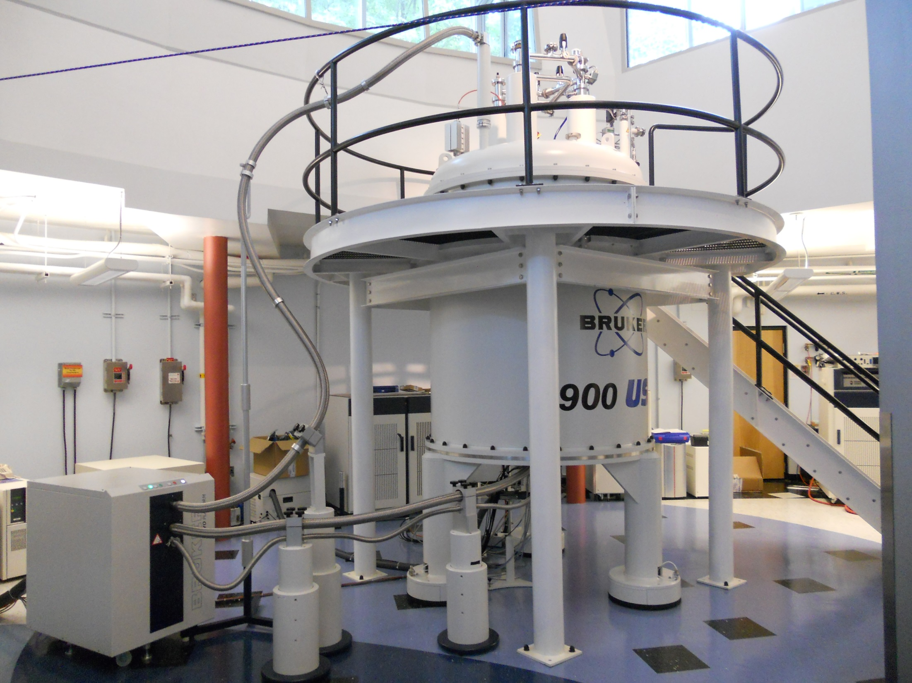
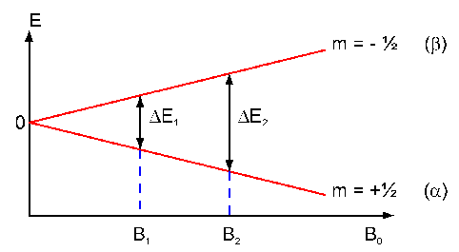
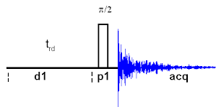
Recap 1 of 4
¹H ¹³C ¹⁵N ³¹P
B_{o}

Slide 5
Recap 2 of 4
ΔE is small so NMR has low sensitivity!
  To improve signal/noise:
  Use concentrated samples
  VERY strong magnetic field: 10s of Tesla
  Use nuclei with large γ ¹H > ¹³C > ¹⁵N
  May need to enrich: ¹H almost 100%, ¹³C and ¹⁵N ~ 1%
  Average signals many times → long experiments (days!)
  Protein stable and unchanged for experiment time

Slide 6
Recap 3 of 4
The 3 main signal features that are sensitive to structure and motions
One nucleus
One signal (or “resonance”)
Each nucleus has its main frequency, whose exact value depends on its chemical environment: CHEMICAL SHIFT
Nuclei are “coupled” through bonds and space: COUPLINGS
Excited nuclei relax through processes regulated by their motions → RELAXATION

Slide 7
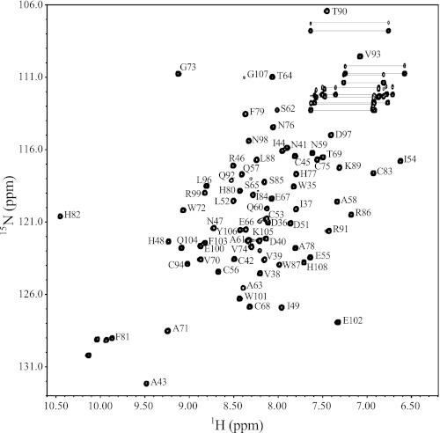
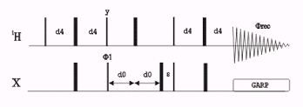
Recap 4 of 4
A very important 2D spectrum: ¹H-¹⁵N HSQC
INEPT (magn. transfer)
(¹³C,¹⁵N…)
1/J
X evolution
(frec for indirect dimension)
R
R
-¹⁵N - C_{α}- CO -¹⁵N - C_{α}
90Hz
H
H
2D ¹⁵N / ¹H correlation through a single bond,
One ¹⁵N-¹H per residue
2-5 min in perfect sample (even seconds with special pulse sequence) to a couple of hours for diluted/bad samples

Slide 8
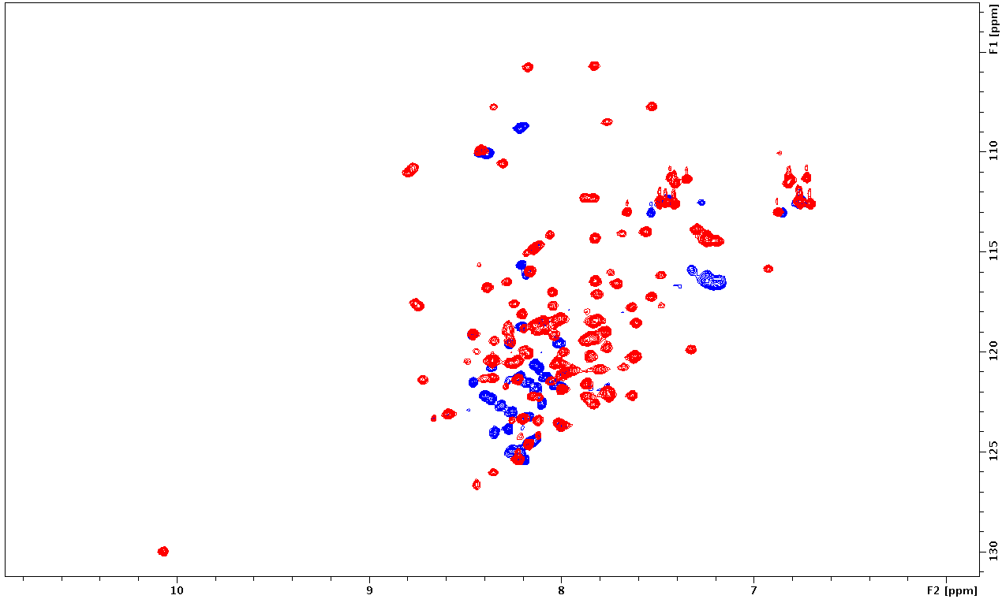
Is protein well folded?
¹⁵N
Partially folded protein
Well folded protein
¹H
F. Sesterhenn , C. Yang, B. Correia

Slide 9
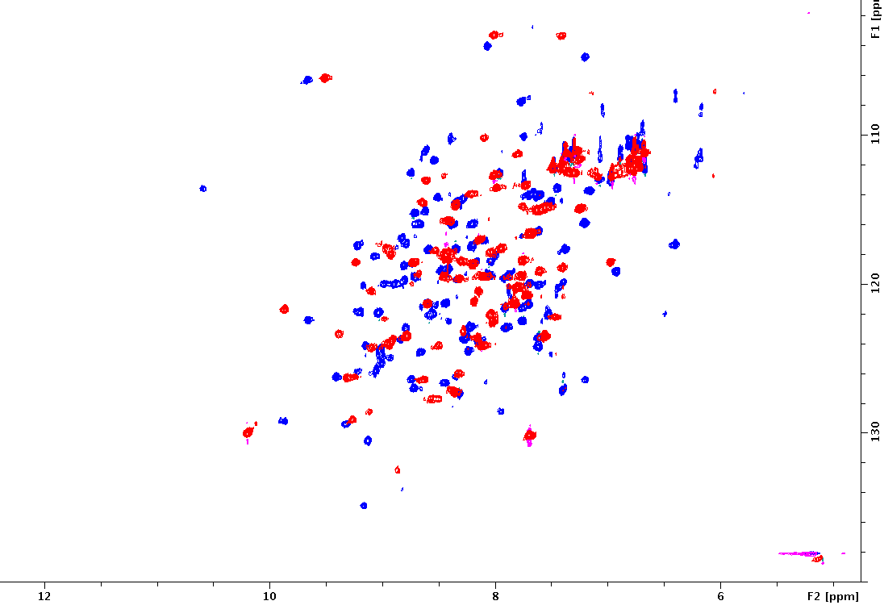
Effect of mutations without re-solving structure
Blue = wt MIF
Red = N72C/A103C
¹⁵N
¹H
N. Haj Yahya, H. Lashuel

Slide 10
Part 2
Relaxation

Slide 11
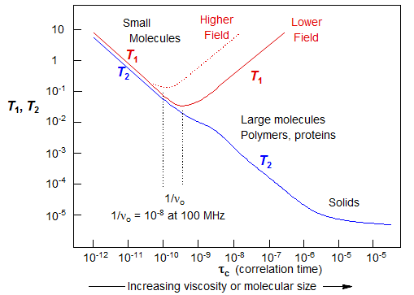
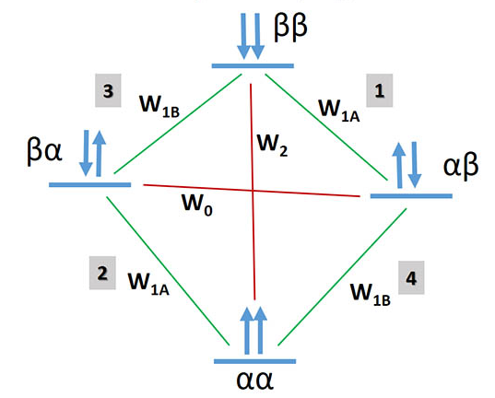
Relaxation = How the system relaxes back to equilibrium after it was excited. It is affected by dynamics, which is not only motions but also chemical exchange processes
Happens through many processes (“relaxation pathways”) | The following is an oversimplification to get to the point:
“Direct” relaxation:
  Spin-lattice (“longitudinal”): measured by T₁
  Spin-spin (“transverse”): measured by T₂
Dipolar couplings: Many pathways, we stay just
with the Heteronuclear NOE
¹⁵N relaxes through T₁ and T₂ in a way that we kind of understand, especially if we also know its heteronuclear relaxation with the attached 1H.
¹⁵N T₁, ¹⁵N T₂ , and ¹H - ¹⁵N NOE combine global rotation and local dynamics
R
-¹⁵N - C_{α}- CO
H
15kDa
1kDa

Slide 12
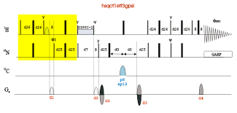
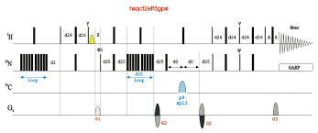
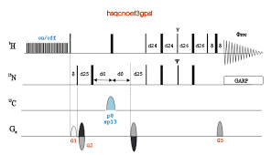
Measuring relaxation
INEPT (magn. transfer)
R
R
-¹⁵N - C_{α}- CO -¹⁵N - C_{α}
Basic HSQC
90Hz
H
H
(¹³C,¹⁵N…)
1/J
X evolution
(frec for indirect dimension)
HSQCs modified to “feel” different kinds of relaxation
Measure ¹H- ¹⁵N NOE (cross relaxation)
Measure ¹⁵N T1
Measure ¹⁵N T2
Tens more…

Slide 13
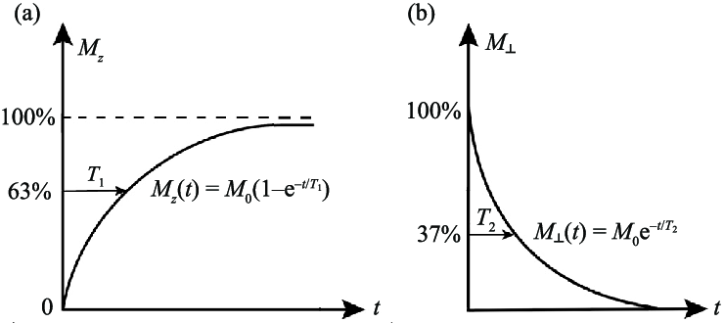
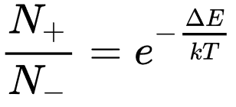
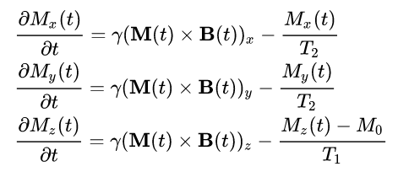
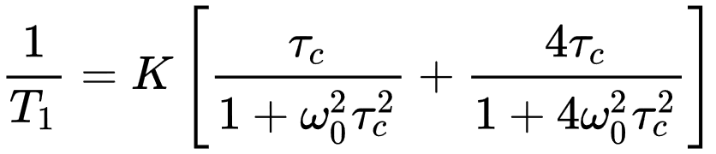
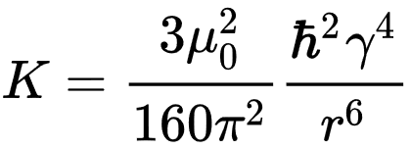
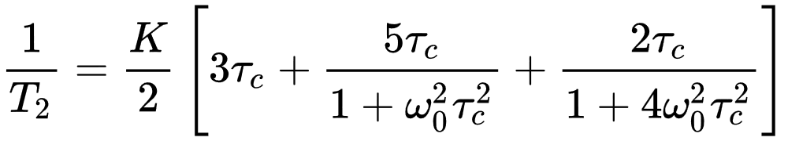
T_{1 measurement}
T_{2 measurement}
¹H-¹⁵N NOE measurement
NOE = irr/noirr
→ ¹⁵N relaxation reports on global tumbling + local motions
https://en.wikipedia.org/wiki/Relaxation_(NMR)

Slide 14
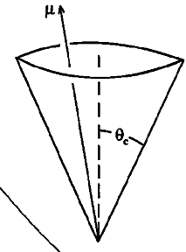
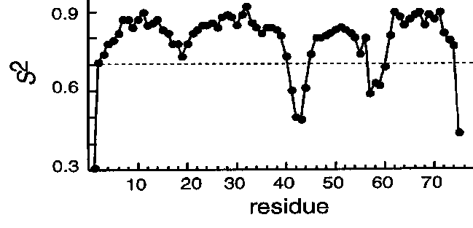
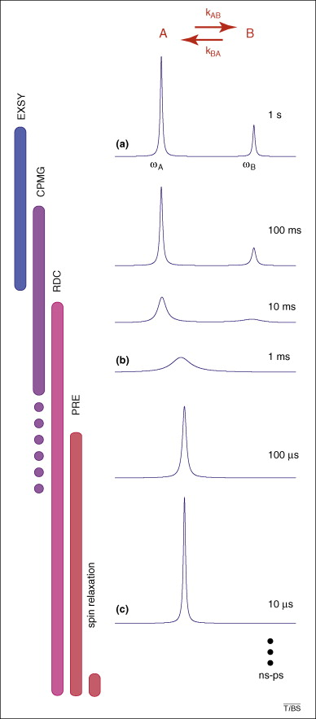
Characterizing Protein Dynamics through the most common ¹⁵N relaxation parameters
Timescale
Days
Hours
Seconds
ms
μs
ns
ps
Global unfolding
Local unfolding
Overall tumbling
V/Librations
Motions
Catalysis
Loop reorientation
S-S flipping
Sidechain reorientation
Aromatic flips
“ModelFree” formalism
HN Exchange
T₂, T_{1rho}
T₁, T₂, H,N-NOE
NMR parameter
/ technique
Real-time NMR
J couplings
RDCs
¹H
Chemical shift
Global contribution to relaxation from global tumbling (τ_{c})
Residue-specific
τ + s² + Rex
¹⁵N
+
ps-ns “motions”
us-ms “motions”

Slide 15
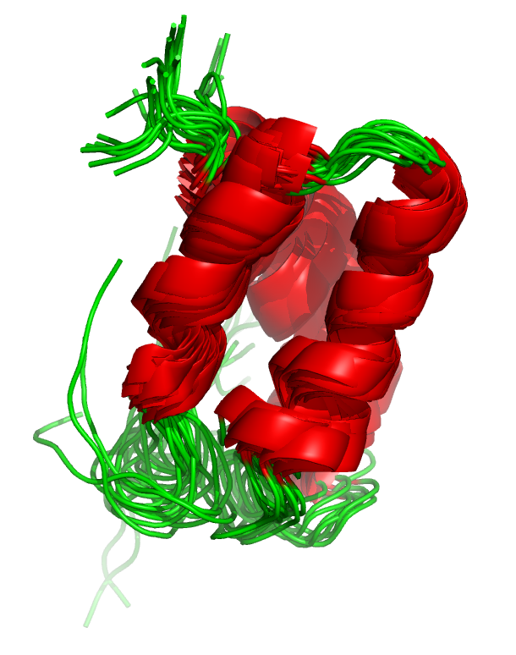
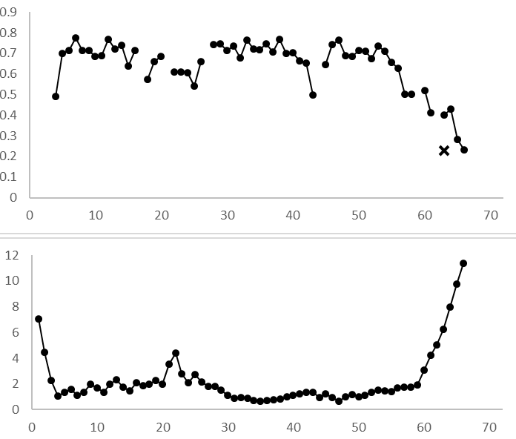
Characterizing Protein Dynamics
Example: is variation real dynamics or due to lack of restraints?
High NOE = rigid
Heteronuclear NOE
Low NOE = ps-ns flexible
Deviation from mean structure
Residue number
F. Sesterhenn , C. Yang, B. Correia

Slide 16
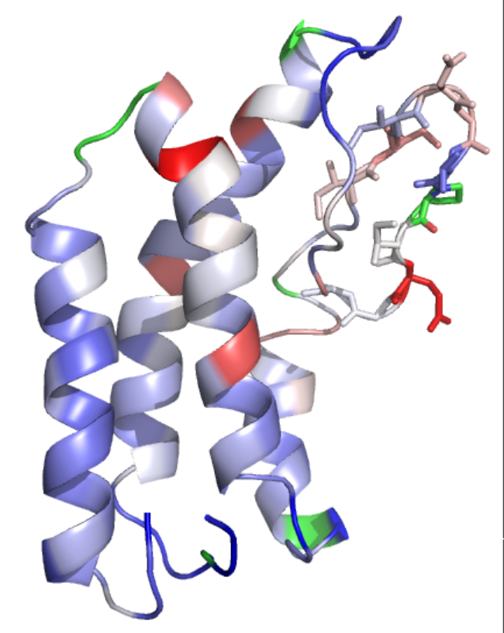
R₂/R₁ on NMR structure
R2/R1
Het. NOE
IIIDGVPIQGG
IIIDGVPIQGG
RMSF
S. Rommelaere, B. Lemaitre

Slide 17
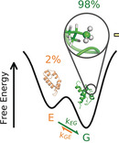
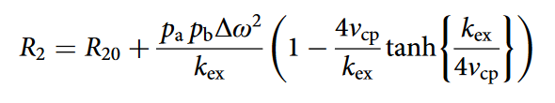
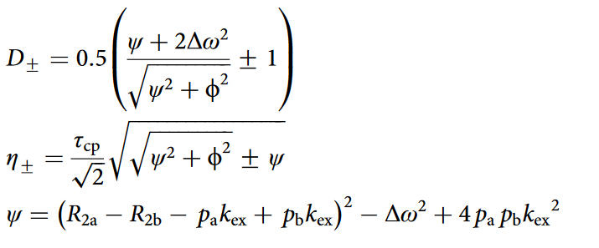
Crazier studies of Protein Dynamics through ¹⁵N relaxation
“Relaxation dispersion” T2
→ Can help to “see” “invisible” states
G(round) state←→ E(xcited) state
Kd = koff / kon = Pb / Pa
Kex = kon + koff
Δω = δb – δa → struct info if ¹³C
Examples:
Solution structure of a minor and transiently formed state of a T4 lysozyme mutant. Nature 2011
Visualizing protein breathing motions associated with aromatic ring flipping. Nature 2022
Structure determination of high-energy states in a dynamic protein ensemble. Nature 2022
A few more… (not easy technique, not many proteins amenable…)

Slide 18
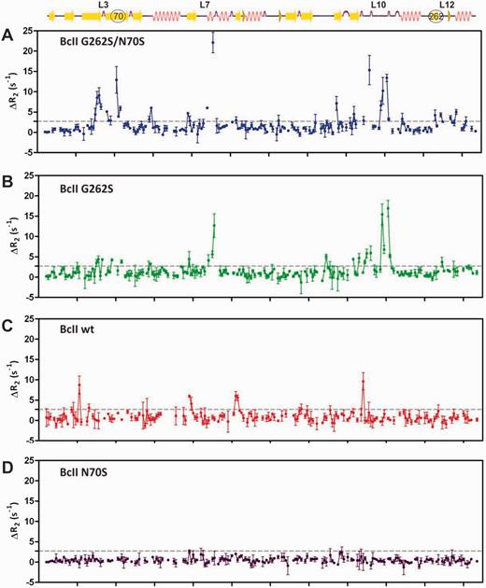
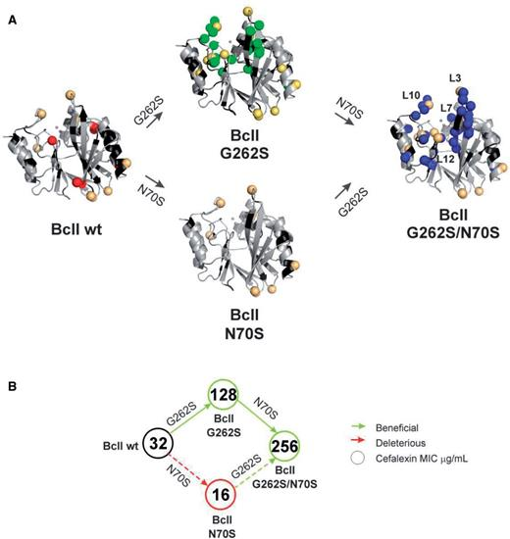
Relaxation dispersion ¹⁵N ex.: Gain of slow-timescale dynamics upon evolution
Residue number

Slide 19
Part 3
Protein – X interactions

Slide 20
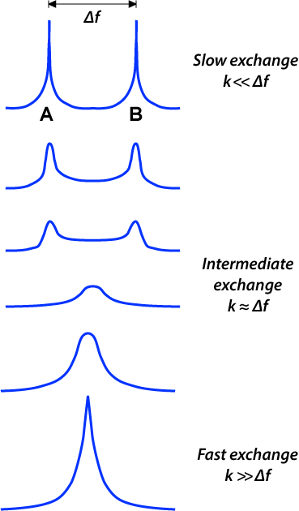
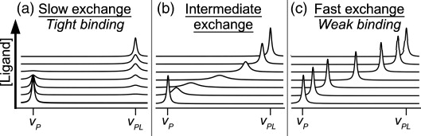
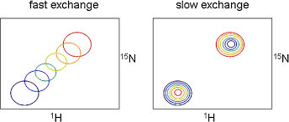
Protein – X interactions
Especially useful when weak, but also works for strong
Faster yes/no than waiting for a crystal to grow or get soaked
Some structural information
Some information about binding kinetics and thermodynamics
Screening in single experiments
2 main ways to study protein-X interactions by NMR:
1) Look at protein labeled in ¹⁵N and/or ¹³C: titrate with unlabeled partners
2) Look at small molecule ((un)labeled) and what it “feels” when you add protein
Before we see examples…. Understand chemical exchange timescales!

Slide 21
1) Look at labeled protein (15N and/or 13C) and add unlabeled interactor
Simple titrations where you monitor signal intensities and/or positions (which, depends on affinity and kinetics)
Or more exotic things like measuring T1, T2, NOE and compare w/ and w/o interactor
If binding is very tight, you might see NOEs between the protein and the interactor
Always good to vary: temperature, pH, salt, co-additives, etc. –everything that tunes kinetics

Slide 22
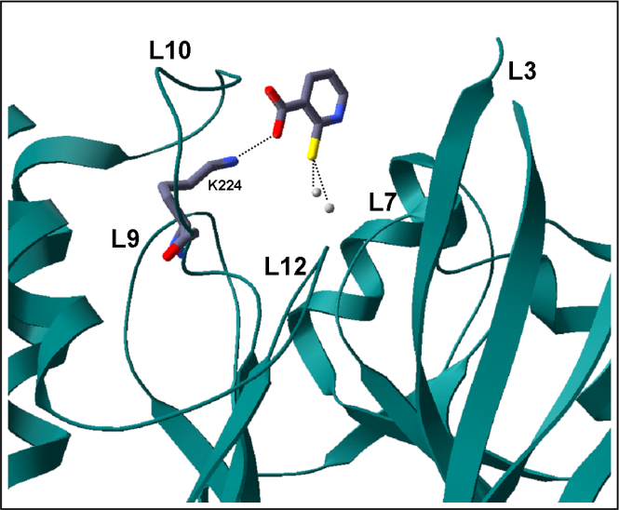
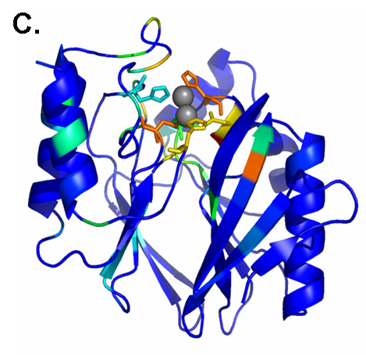
Ex 1: Protein – small mol interaction of uM-mM affinity
10
8
6
-
-
-
Free
Bound
110 -
- 110
δ_{15N} (ppm)
120 -
- 120
130 -
- 130
-
-
-
10
8
6
δ_{1H} (ppm)
M.E. Zaballa, A.J. Vila

Slide 23
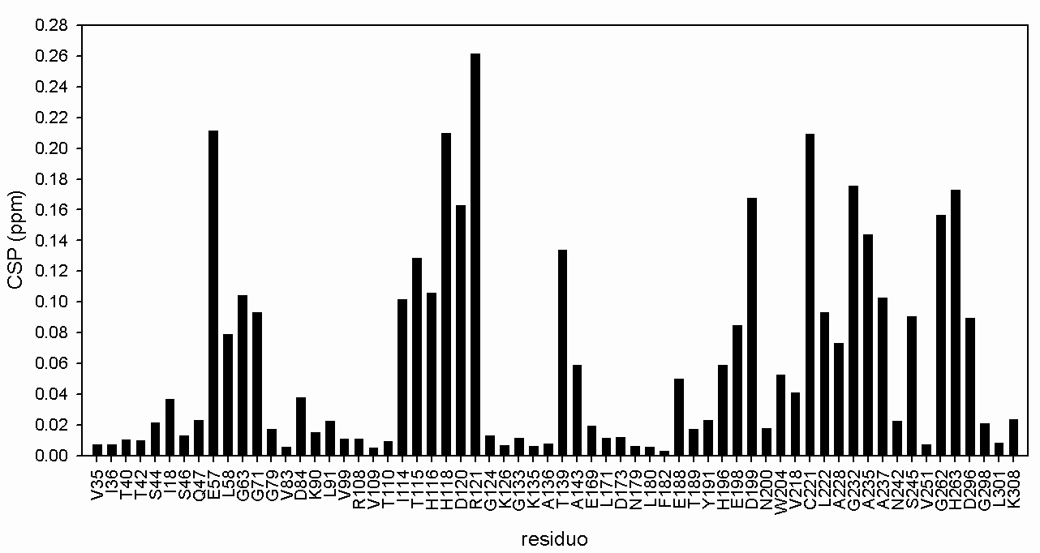
Ex 1: Protein – small mol interaction of uM-mM affinity
Chemical Shift Perturbation (CSP) mapped on the protein sequence
CSP = (Δδ(¹H)² + Δδ(¹⁵N)²/25)^{1/2} ppm
L3
L7
L10

Slide 24
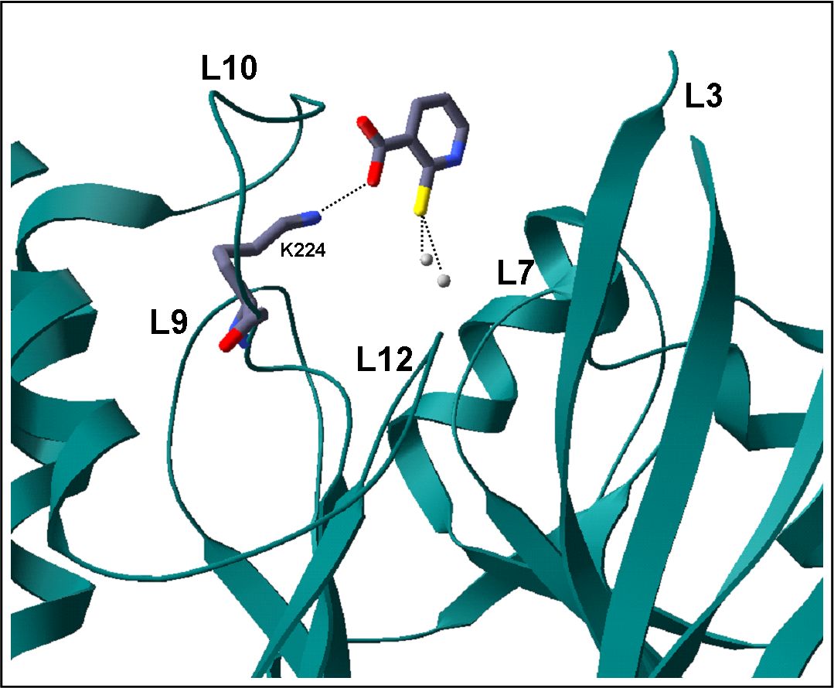
Ex 1: Protein – small mol interaction of uM-mM affinity
Chemical Shift Perturbation (CSP) mapped on the protein structure
L10
0.3
CSP (ppm)
0
Small molecule docked using CSPs

Slide 25
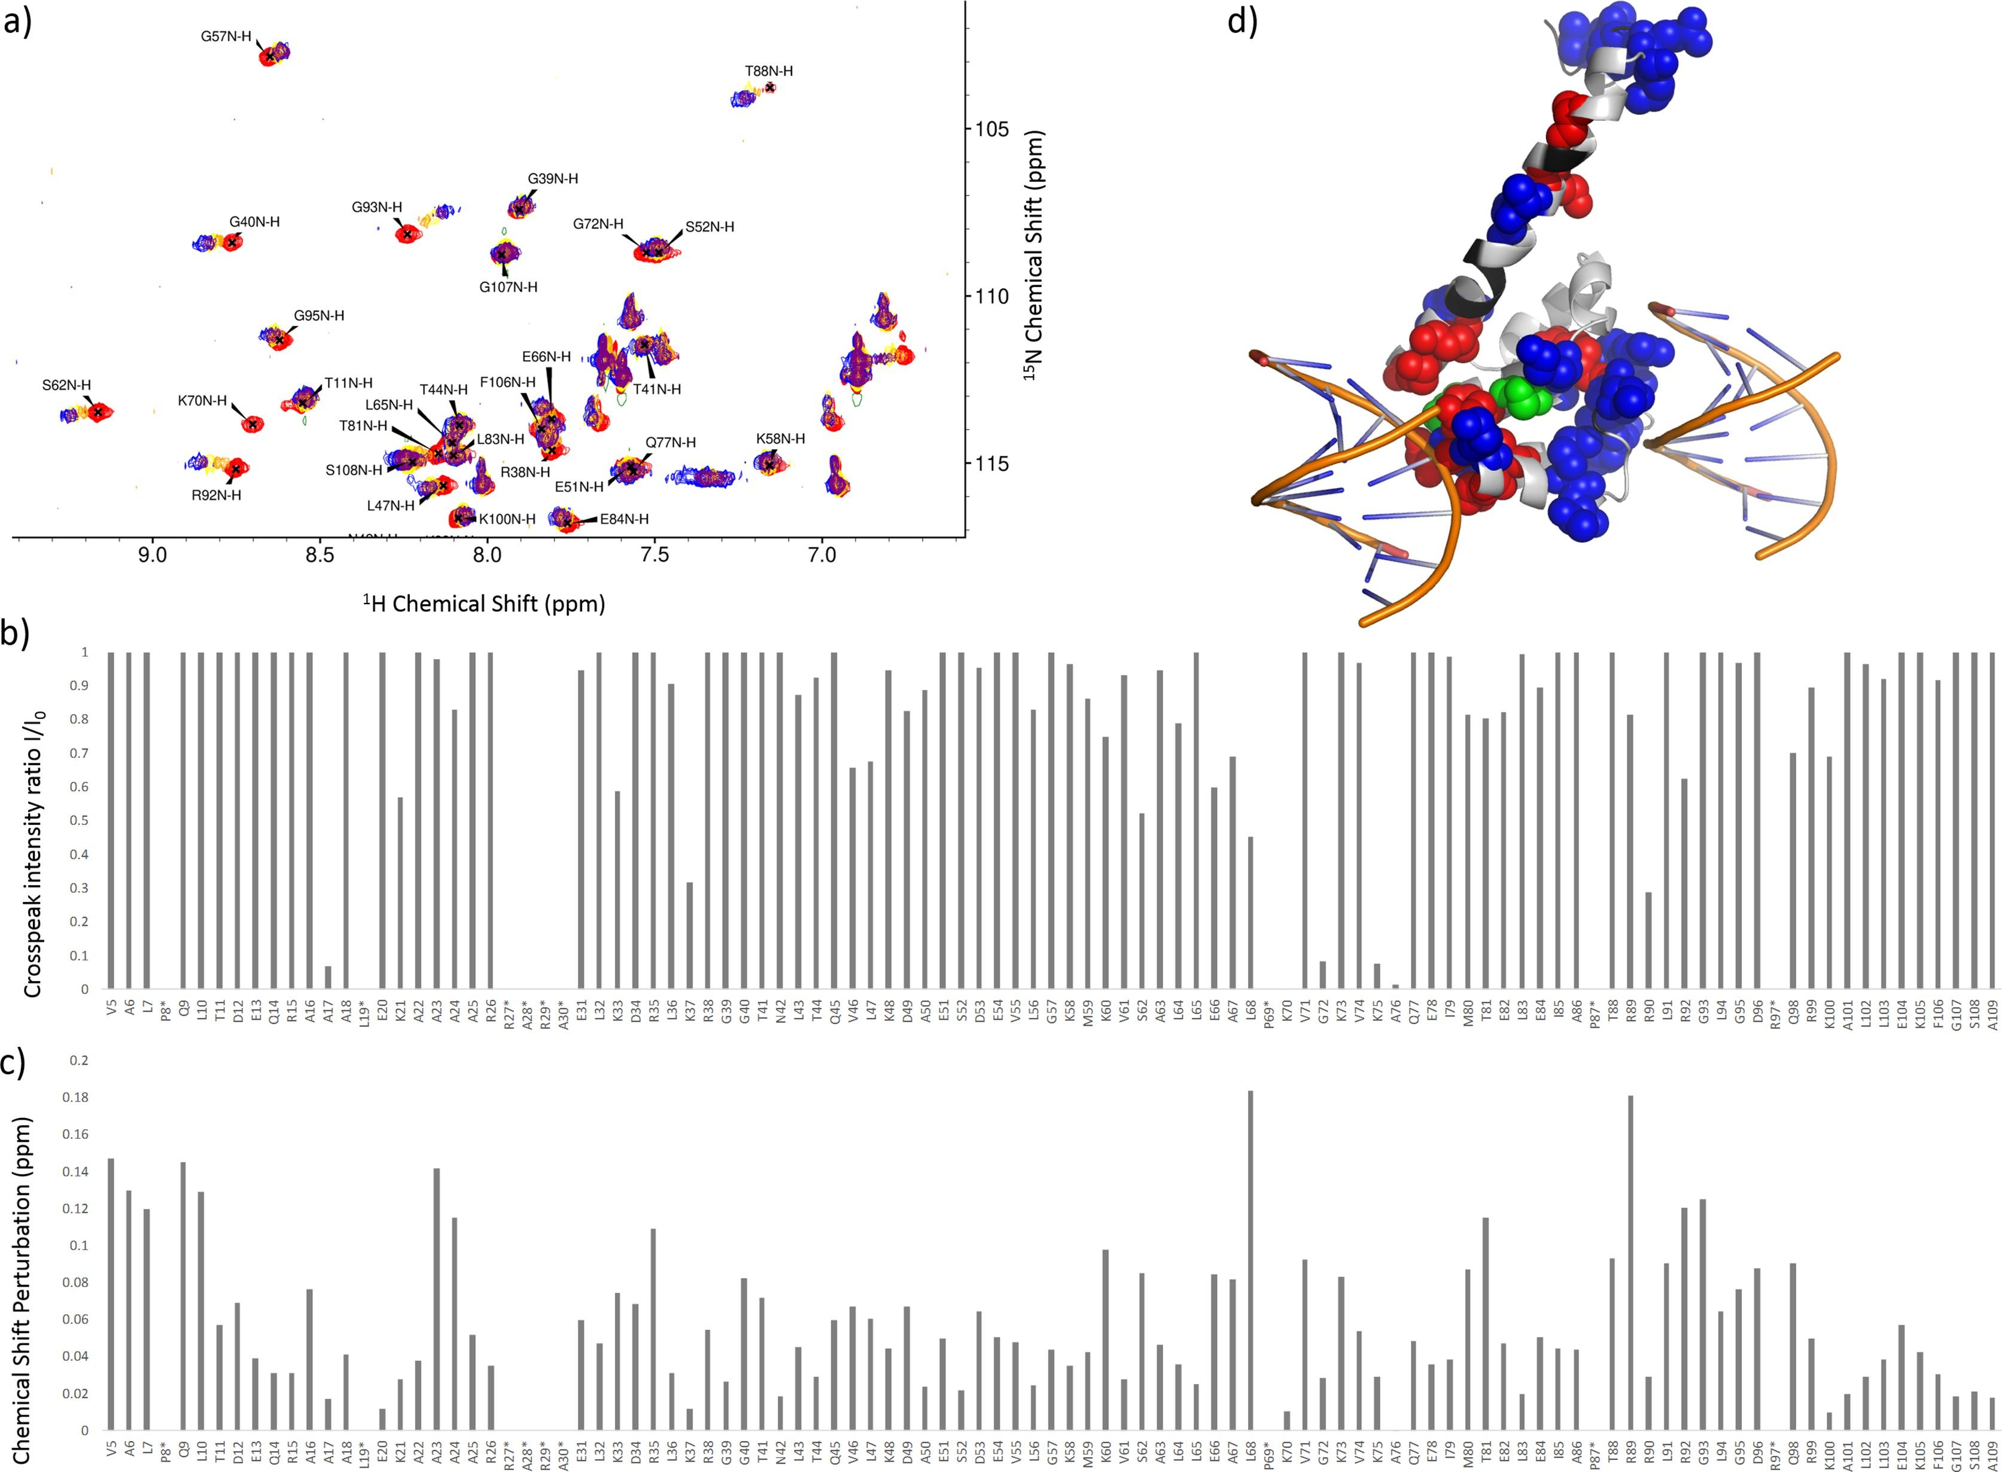
Ex 2: Protein – DNA interaction of uM-nM affinity
Peaks move and broaden, then appear somewhere else
N. Odermatt , S. Cole

Slide 26
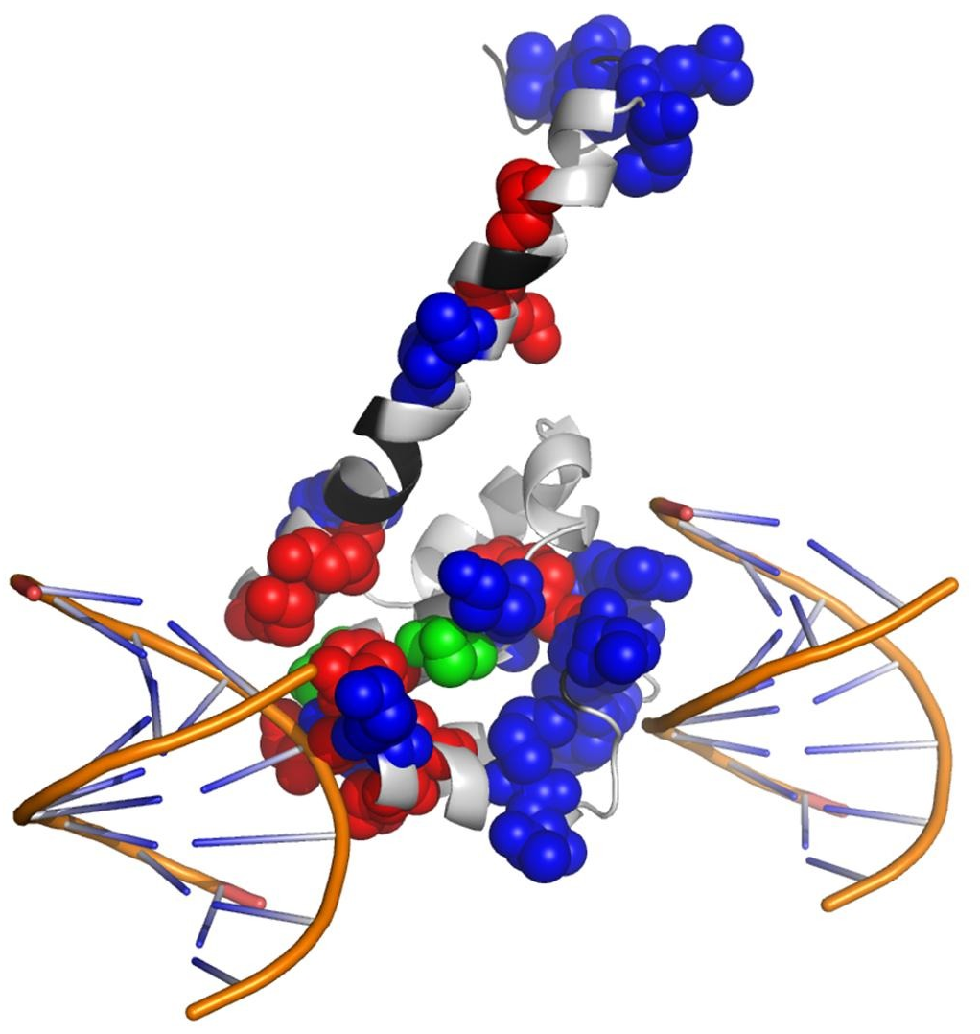
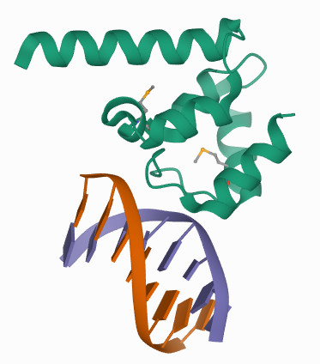
Ex 2: Protein – DNA interaction of uM-nM affinity
Peaks move and broaden, then appear somewhere else
Conclusion?
Info mapped on pre-existing structure (PDB 4ITQ) –and here’s something interesting to say
Biological assembly as deposited for PDB 4ITQ
Red: drop in intensity (stronger affinity)
Blue: strong CSPs (lower affinity)
Green: both drop in intensity and shift
(Black = no data (prolines + unassigned)
Copy crystal symmetry (in PyMOL:
symexp sym,4itq,(4itq),3) + superimpose

Slide 27
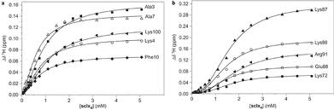
All this is by far much simpler than solving an X-ray structure of the complex
Works even for transient complexes, low affinity, and very flexible systems
From this you can get binding constants
For best examples, see papers and reviews by Marcelus Ubbink
https://scholar.google.nl/citations?user=lJXN2LgAAAAJ&hl=en

Slide 28
2) Look at small molecule ((un)labeled) and
what it “feels” when you add protein
Diffusion coefficient
T2 (nice!), T1 (not very clear)
Saturation transfer (nice!)
WaterLOGSY (no experience)
etc.
Direct NOE
Chemical shift
etc.
Only mid to weak binding, but each parameter has different sensitivity, so you better try many exps.
Concept of “lead screening” by NMR: find interacting molecule/s in a soup; then optimize
Only mid to strong binding, but each parameter has different sensitivity, so same as above
Always good to vary: temperature, pH, salt, co-additives, etc. –everything that tunes kinetics

Slide 29
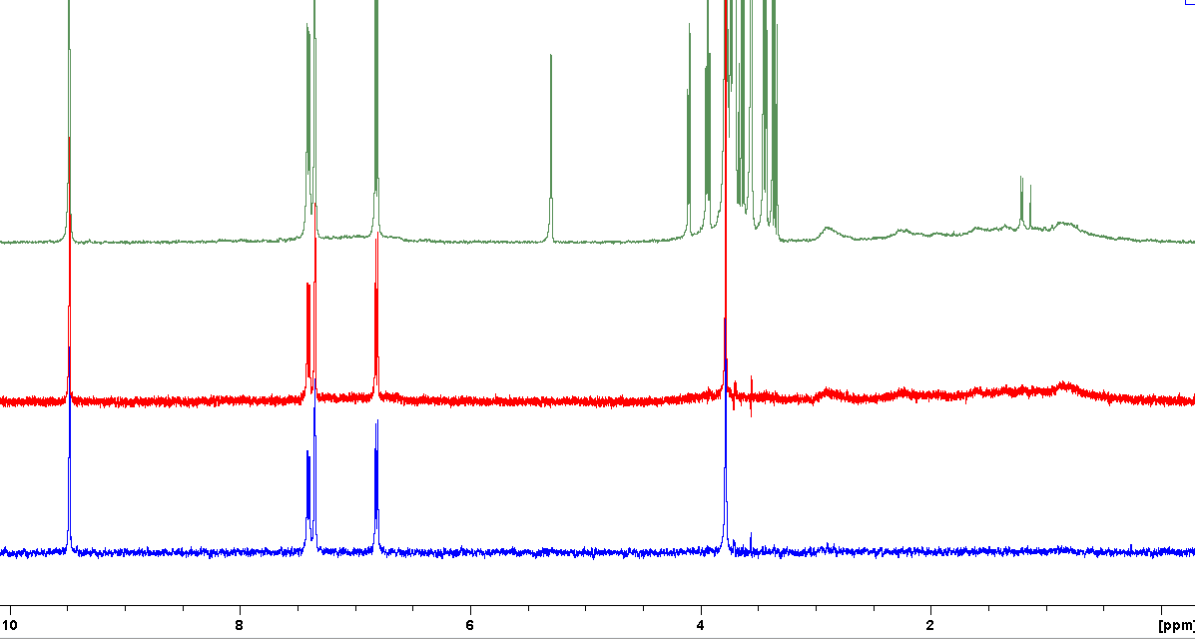
Ex 1: Saturation Transfer Difference
Idea: Irradiate protein and see if and which small molecules “respond”
Self-consistent experiment: irradiate on and off resonance.
1mM vanillin + 1mM sucrose + 10 uM BSA (known to bind only vanillin)
BSA
Normal ¹H spectrum
STD irr. 0 ppm
In principle applicable to more complex mixtures too
STD irr. 0 ppm
+ 400 ms T2 filter
C. Siri, F. Stellacci

Slide 30
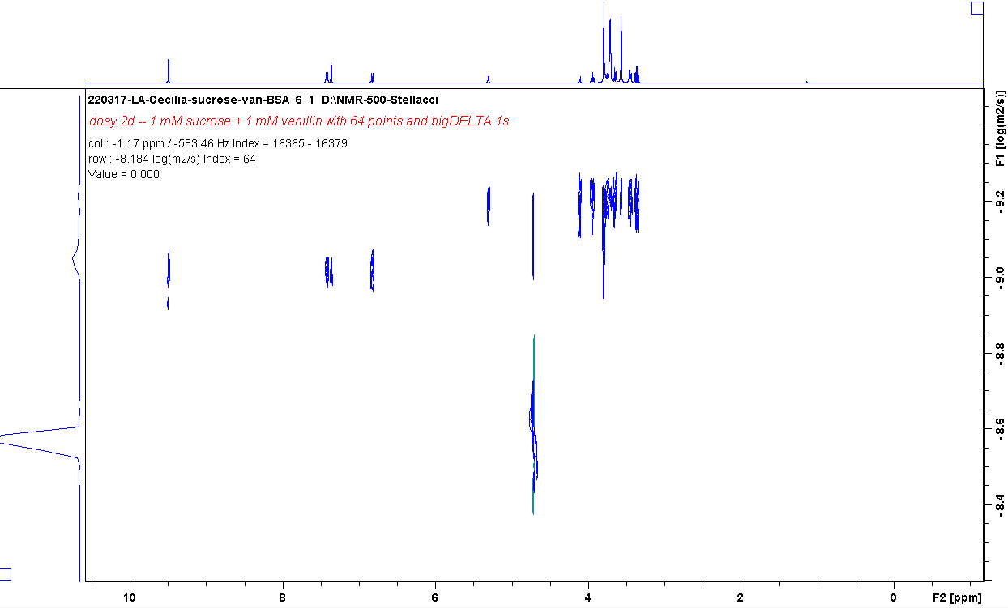
Ex 2: DOSY (Diffusion-Ordered SpectroscopY) -A.K.A. Pulsed-Field Gradients (you may often find it w/ this name)
1mM vanillin + 1mM sucrose
Sucrose
Vanillin
log(Diffusion coefficient)
Water
1H chemical shift (ppm)
C. Siri, F. Stellacci

Slide 31
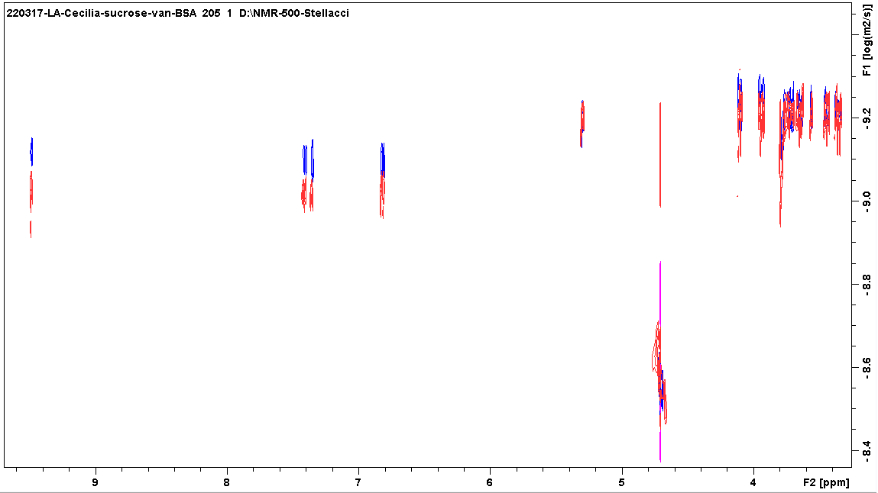
Ex 1: DOSY (Diffusion-Ordered SpectroscopY) -A.K.A. Pulsed-Field Gradients (you may often find it w/ this name)
1mM vanillin + 1mM sucrose + 10 uM BSA (known to bind only vanillin)
Sucrose unaffected
10uM BSA
Vanillin
No BSA
log(Diffusion coefficient)
Vanillin’s diffusion coefficient ~ 20% lower because it got bound.
→ Could be used to screen binders vs. non-binders.
→ Could get K_{D} by measuring D at various vanillin & BSA concentrations (low accuracy, though)
Water
1H chemical shift (ppm)

Slide 32
Thank you and remember:
NMR is much more than structures
Effects of mutations just by looking at spectra
Interactions with other proteins, XNA or ligands
Screening ligands in mixtures
Dynamics over vast timescales
Residue-specific pH titrations
Water exchange dynamics
Hydrogen bonds
Intrinsically disordered proteins & peptides
Selectively labeled samples –not changing chemistry
Structural biology in vivo, in cells, in lysate, in highly crowded conditions –thanks to isotope enrichment

Slide 33
Part 4
“Disordered” proteins and peptides

Slide 34
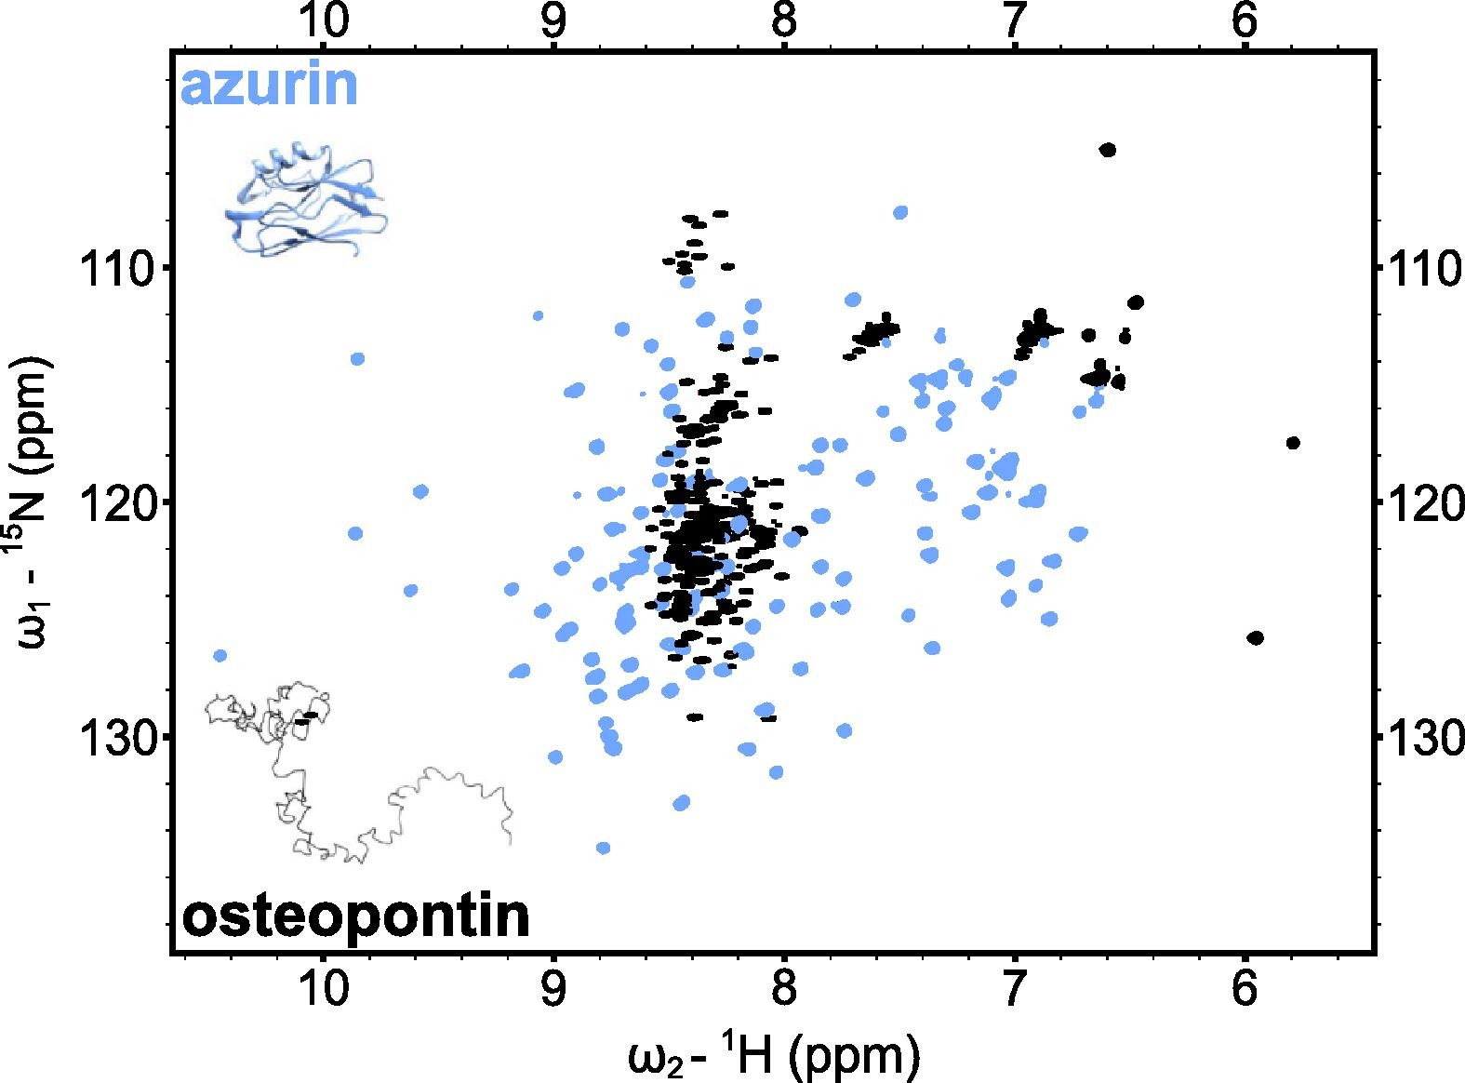
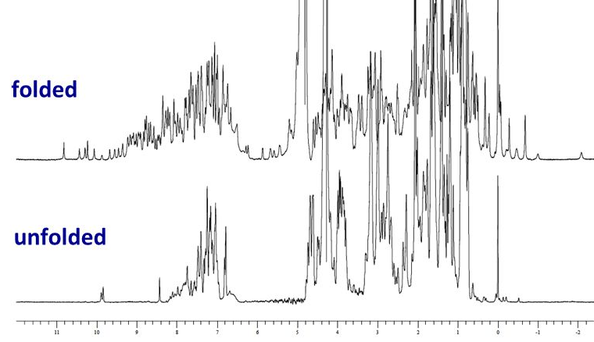
Protein folded or not? From inspection of NMR spectra, much more sensitive than CD
δ ¹H (ppm)
Unfolded protein ~ Mixture of amino acids if no residual structure is present (“propensities”)
Unfolded protein ≠ Molten globule ≠ Folded protein

Slide 35
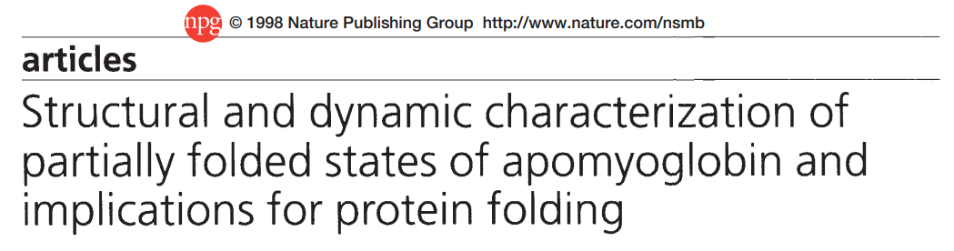

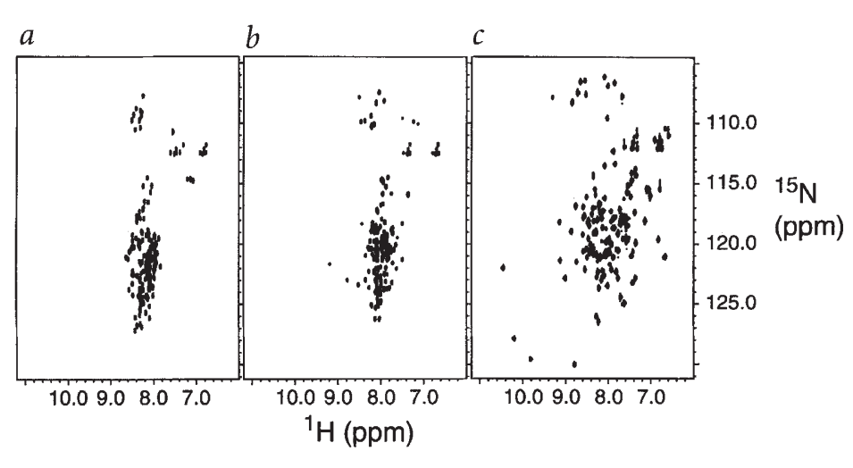
A paper exploring disordered vs. molten globules and folded states, and developing on folding mechanisms
https://www.nature.com/articles/nsb0298-148.pdf

Slide 36
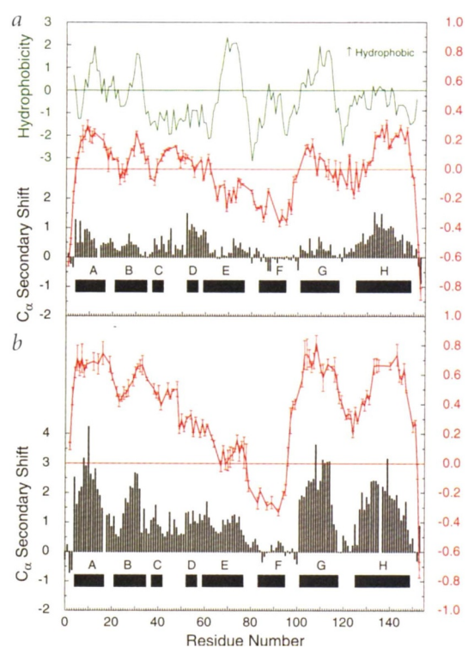
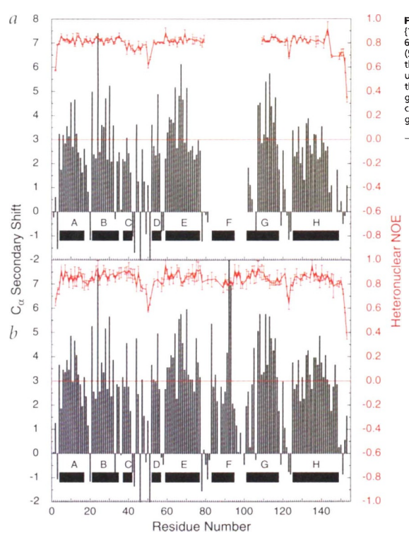
A paper exploring disordered vs. molten globules and folded states, and developing on folding mechanisms
U
N(apo)
I(MG)
N(holo)

Slide 37
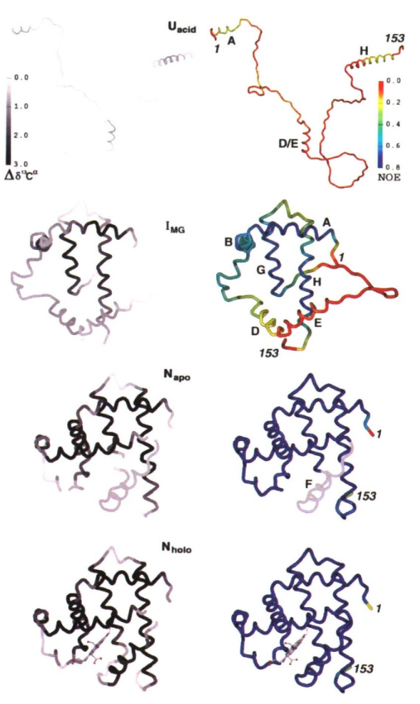

https://www.nature.com/articles/nsb0298-148.pdf

Slide 38

Peptides and disordered proteins in solution
Even though peptide binds in a strongly helical conformation, it is very floppy in solution
X. Kong, F. Pojer, C. Heinis

Slide 39






Peptides and disordered proteins in solution
Ice-binding peptide, cyclized through Cys
XCCXXXXXCXXXXCXXXX
Structure in solution? Esp. C-C bonding ?
High solubility → natural abundance of ¹³C and ¹⁵N
(1% and 0.1%)
C. Stevens, H.-A. Klok

Slide 40
Some key reviews about IDPs focusing on NMR (and there’s even more…)
https://pubs.acs.org/doi/10.1021/ja101645g
https://pubs.acs.org/toc/chreay/114/13 (Chem Rev issue on IDPs)
https://pubs.acs.org/doi/full/10.1021/cr400695p (Chem Rev on IDPs in cells)
https://www.sciencedirect.com/science/article/pii/S0003986117302977?via%3Dihub
https://reader.elsevier.com/reader/sd/pii/S0003986119311464?token=6BED663424C04229DCE87D18109BC3ADEF35AF3BCC96E8F943527EE5D640E3760E1246D6A37767C9FFDAB43013FD017B&originRegion=eu-west-1&originCreation=20220309171930
https://www.sciencedirect.com/science/article/pii/S0959440X21000531?via%3Dihub
https://analyticalsciencejournals.onlinelibrary.wiley.com/doi/10.1002/pmic.201800055
https://www.mdpi.com/2218-273X/12/1/27/htm (NMR + Fluo techniques)
https://link.springer.com/content/pdf/10.1007/s10858-019-00280-2.pdf (perspective but instructive)
https://www.sciencedirect.com/science/article/pii/S1046202318300082

Slide 41

1000s of papers studying IDPs or ID segments with NMR.
A perspective by two of the leaders, J. Dyson + P. Wright, has it “all”. ← I will focus on this
NMR people see proteins in a somewhat different way than X-ray / Cryo people.
Closer to MD people but like if MD worked, especially about timescales.
This because of the amenability to disordered proteins.
The perspective follows a historical timeline, making it even nicer to read.
https://link.springer.com/content/pdf/10.1007/s10858-019-00280-2.pdf

Slide 42


> half of the proteome is disordered
IDPs are inherently dynamic and sample an ensemble of conformations in solution
But not just crazy disordered: ensembles, propensities, stabilizing interactions, etc.
Struct biol approach very reductionistic: ordered & disord proteins studied separately
True situation inside cells very complex as folded proteins and IDPs share spaces
Fuzzy complexes: Even in nM cases, the IDP might retain disorder.
Extreme case in https://www.nature.com/articles/nature25762
“Extreme disorder in an ultrahigh-affinity complex”

Slide 43
Part 4-B
Biochemistry at atomic-resolution on disordered proteins

Slide 44


In-cell / In vivo protein NMR

Slide 45


Labeling proteins for in vivo NMR
Deliver proteins into various mammalian cells by electroporation
Inject ¹³C,¹⁵N protein into oocytes
Switch bacteria from rich to in ¹³C,¹⁵N medium and start protein expression
Deliver proteins fused with cell penetrating peptides into various mammalian cells
Deliver proteins into various mammalian cells through pore-forming toxins
Adapted from Erica Secci’s PhD thesis, CERM: https://pdfs.semanticscholar.org/afe8/736a87a37cbb374a5249c232e85076dcfa2b.pdf

Slide 46

Example
Synuclein remains IDP inside cells
Compared NMR in:
Solution
Crowded solution
Cell lysates
Model cells
https://www.nature.com/articles/nature16531
α-Syn dynamics in cells and crowded solutions. a) Residue resolved NMR signal intensity ratios (I/I_{o}) of α-Syn in A2780 and SK-N-SH cells (red) identify regions of site-selective line broadening (marked by arrows). No line broadening of N-terminally acetylated α-Syn is observed in the presence of Ficoll (blue), whereas BSA (green) and lysozyme (orange) recapitulate signal attenuations of N- and C-terminal residues, respectively. For simplification, all profiles show values averaged over three consecutively resolved residues. AU, arbitrary units. b) Residue resolved rotational correlation time (τ_{c}), or mobility, of N-terminally acetylated α-Syn in buffer (gray), in cells (red), and in the presence of different crowding agents (averaged over three consecutively resolved residues) reveal uniform reductions of fast protein motions. c) Site-specific exchange contributions (Rex) identify α-Syn regions that engage in weak transient interactions with cytoplasmic components (marked with arrows). Substitution of Phe4 and Tyr39 with alanine residues (F4A;Y39A) reduces N-terminal Rex terms in cells (light red) and in BSA-crowded solutions (light green), thus identifying hydrophobic contacts as the source of N-terminal exchange contributions. Higher salt concentrations diminish C-terminal α-Syn interactions with lysozyme (light orange), arguing for electrostatic effects. Different from BSA-crowded solutions, only residues 1–20 of N-terminally acetylated α-Syn exhibit pronounced exchange contributions in the presence of sub-saturating amounts of SUVs (blue), which are diminished for α-Syn (F4A;Y39A) (light blue)

Slide 47







https://www.nature.com/articles/ncomms10251?origin=ppub

Slide 48




Slide 49
Part 5
Hands-on work on some spectra

Slide 50
Hands-on: What happened when a kinase tried to phosphorylate this protein substrate?
Experiment:
Given a protein for which we have assignments,
We added a kinase + Mg⁺² + ATP, and monitored phosphorylation by HSQC spectra at 30 C.

Slide 51

Disordered proteins & peptides in solution
MATLEKLMKAFESLKSFQQQQQQ...QQQQQQPPPPPPPPPPPQLPQPPPQAQPLLPQPQPPPPPPPPPPGPAVAEEPLHRP
¹⁵N
Gly79
For a well-folded protein:
Ser13 & 16
PolyQ
Gln19
Phe11
Gln18
Gln39
Val82
Glu5
Lys9
Glu12
Gln40
Met8
Phe17
Lys15
Leu7
Glu84
Lys6
Leu14
¹³C further unveils residual structure in disordered proteins
Leu4
Ala10
Ala60
Ala81
Ala83
¹H

Slide 52

Protein + kinase + ATP + Mg
Gly79
Before adding ATP
After full phosphorylation
Ser13 & 16
PolyQ
Gln19
Phe11
Gln18
Gln39
Val82
Glu12
Glu5
Lys9
Gln40
Met8
Phe17
Lys15
Leu7
Glu84
Lys6
Leu14
Leu4
Ala10
Ala81
Ala60
Ala83

Slide 53
The phosphorylation reaction itself is monitored by consecutive ¹H, ¹⁵N HSQCs
t = 59
t = 19
t = 39
t = 79
t = 109
t = 119
t = 29
t = 49
t = 9
t = 69
t = 89
t = 2
t = 99
t = 0
t = 1
t = 4
t = 6
All this in TBK1 reaction buffer, at 293 K, spectra take 3 min or 10 min

Slide 54
Conclusion 1) phosphorylation of Ser13 happens first and “primes” that of Ser16
Example data Met reduced
Simulation of priming with equal rates and KMs

Slide 55

Conclusion 2) Oxidized methionine seems to foster phosphorylation by TBK1
Met8ox, essentially fully phosphorylated in 5 hours
Met8red, not fully phosphorylated even after 20 hs

Slide 56
Thank you and remember:
NMR is much more than structures
Effects of mutations just by looking at spectra
Interactions with other proteins, XNA or ligands
Screening ligands in mixtures
Dynamics over vast timescales
Residue-specific pH titrations
Water exchange dynamics
Hydrogen bonds
Intrinsically disordered proteins & peptides
Selectively labeled samples –not changing chemistry
Structural biology in vivo, in cells, in lysate, in highly crowded conditions –thanks to isotope enrichment
More exotic: paramagnetic metals and probes, diffusion spectroscopy, NMR in MRI…

Slide 57
Some hands-on work
Analyze titration of ¹⁵N NBR1 with ubiquitin
  CARA: http://cara.nmr.ch/doku.php/cara_downloads
  Computer mouse
  Download zip file with all material for practical (moodle)
  Reference PDB: 2MJ5

Slide 58
Analyze titration of
apo calmodulin with calcium
Read about calmodulin beforehand:
https://pdb101.rcsb.org/motm/44
Have Pymol or some other molecular viewer installed
Have Sparky installed and check that it works
Download all these files:
  http://lucianoabriata.altervista.org/tmptransfers/230203_LA_Calmodulin_15N.zip
  http://lucianoabriata.altervista.org/tmptransfers/analyses_on_my_own_titration.zip
  Sparky commands: fo file open fs file save F1/F8/F11 rp read peaks
  ct set contours st set calibration, spectrum name, etc ol overlay
Apo (no Ca) expno 4
0.4 eq Ca expno 1005
0.8 1007
1.0 1008
1.2 1009
1.5 1010
6
7
8
9
10
11

